Slide 1
DR. KANAILAL BHATTACHARYYA COLLEGE
STUDY MATERIAL FOR
ONLINE CLASS,
B.Sc. SEMESTER- III (HONOURS) STUDENTS UNDER CBCS SYSTEM
SUBJECT: BOTANY
PAPER: PLANT SYSTEMATICS
(CC-7)
TOPIC: SYSTEMATICS IN PRACTICE
SUBTOPIC: HERBARIUM
BY
DR. DIPU SAMANTA
(DEPARTMENT OF BOTANY)
FOR CORRESPONDENCE: dipusamanta2010@gmail.com

Slide 2
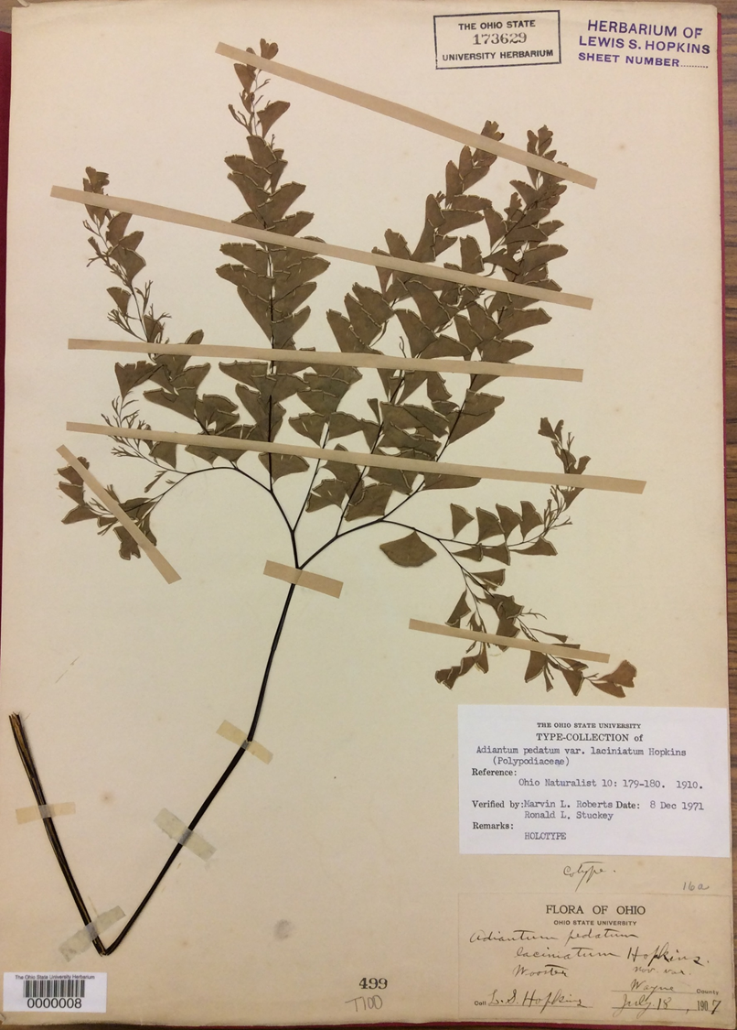
Herbarium
A herbarium is a store house of plant specimens in dried, pressed, preserved and mounted plant specimens are arranged in a sequence of an accepted system of classification for future reference and study.
The collected plant specimens from far and wide, mounted on appropriate sheets and kept in pigeon holes of steel or wooden cupboards for study at the same place and time.

Slide 4
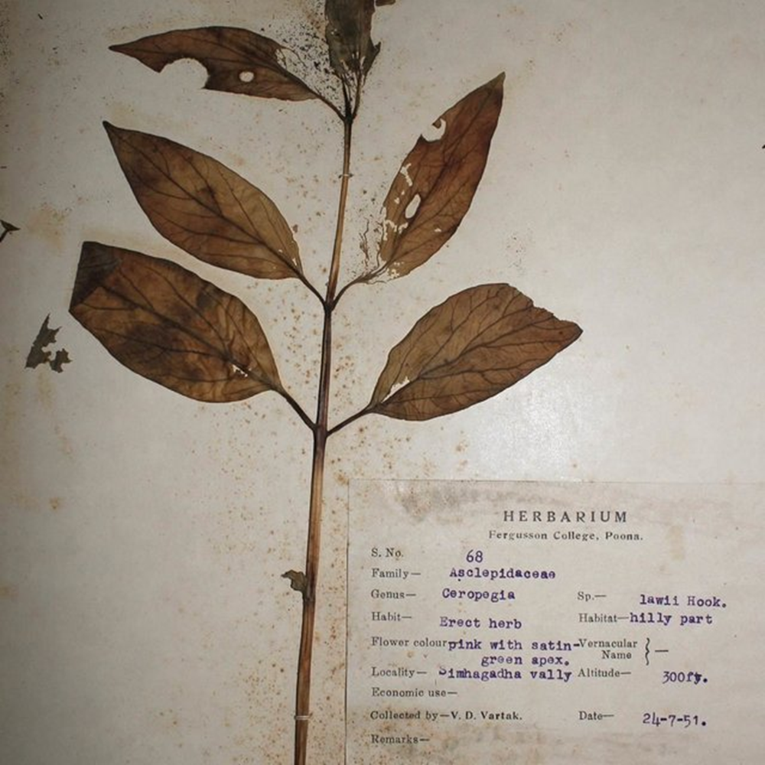
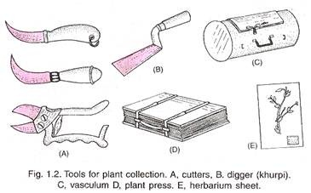
PREPARATION OF HERBARIUM SPECIMEN

Slide 5
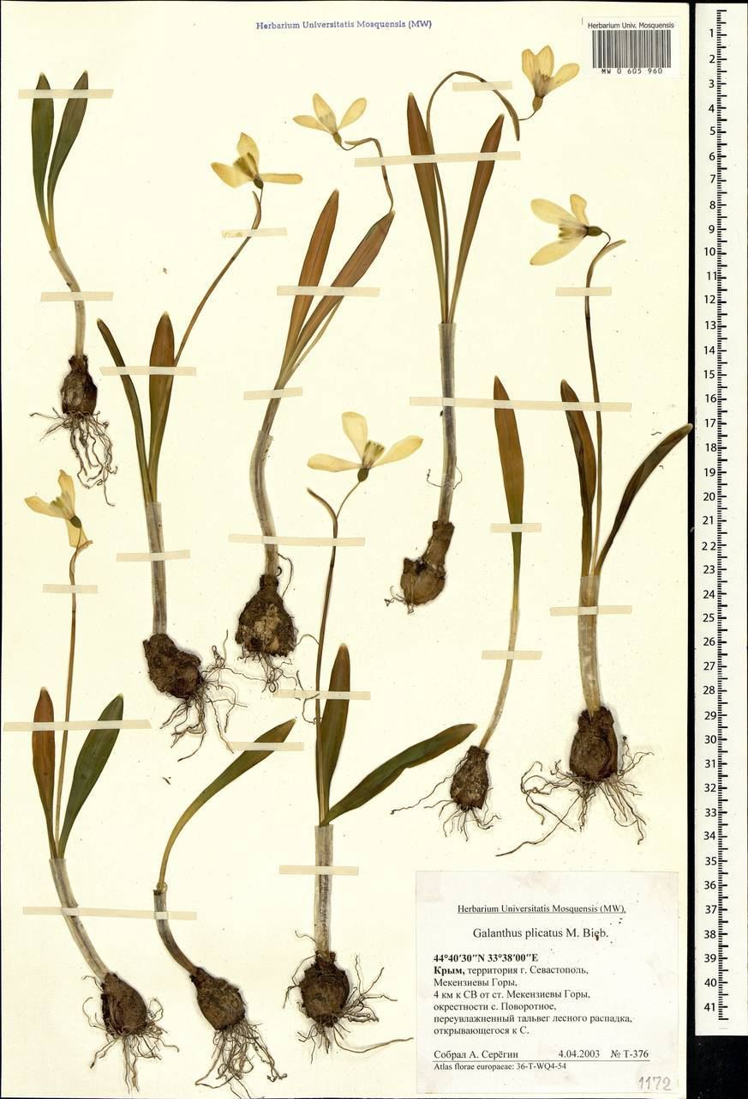
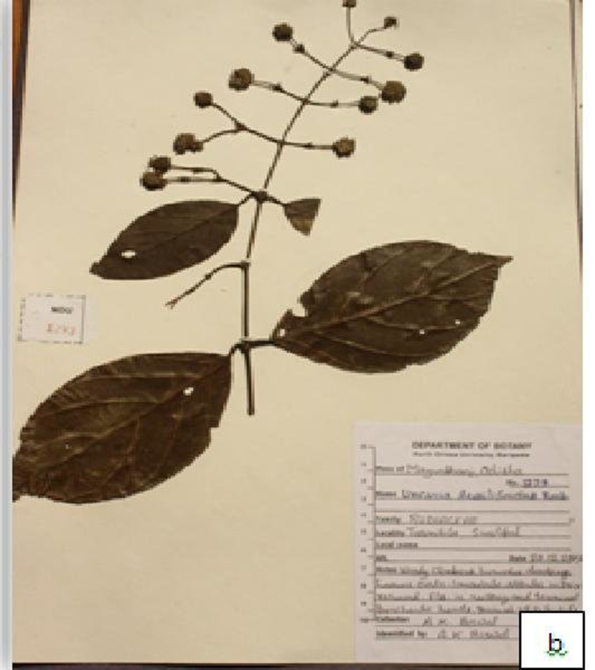
a
HERBARIUM SPECIMENS

Slide 6
Functions of Herbarium:
The main and valuable functions of herbarium are:
a) Conservatory of material and data:
The herbarium is a storehouse of plant materials with valuable data mentioned on their labels.
The material in the herbarium remains as permanent record of flora of those regions even the natural topography and the vegetation have changed or extinct. In these the herbarium provide evidence of what once existed.
The herbarium specimens bear labels with adequate data on habitat, common name, native uses, ecological notes like frequency and abundance of species, associated plants, habit etc.
These types of data for the particular species, but from different collections of different regions, when carefully studied and analysed, provides valuable material for almost complete description of various taxonomic characters such as morphological range of variation, distribution etc.
A herbarium receives fresh material by collection of its staff, through gifts, exchanges etc. So it is a conservatory of material and data.

Slide 7
b) Role of herbarium in teaching and research:
Herbarium acts as an aid in teaching botany to degree and post-graduate students. While teaching a teacher can show herbarium specimens if fresh material is not available at the time of giving the course.
It is of essential requirement for biosystematic research i.e., for correct identification and nomenclature besides a source of material. It provides research material for anatomical, palynological and chemotaxonomical studies.

Slide 8
Some other significances are:
1. It provides valuable data and material.
2. Helped in all kinds of taxonomic researches.
3. It aids in assessment of conservation status of a taxon.
4. It acts as an aid in taxonomical researches.
5. It serves as a fundamental resource of identification of almost all plants of country and even world.
6. As source of estimation of global biodiversity.
7. It is a base line for data on distribution and abundance of keystone species.
8. It helps in distributional range and population biological studies.
9. The specimen tag carries all the information about habitat, habit, local name, flower colour, etc., of plant specimen for further botanical, ethnototanical phytogeographical studies etc.
10. It may be useful as source of material for anatomy, palynology cytotaxonomy biochemistry, pharmacognosy etc. studies.
11. Herbarium serves as an aid in teaching plant taxonomy.
12. It may provide seeds of extinct plant species for further studies.

Slide 9
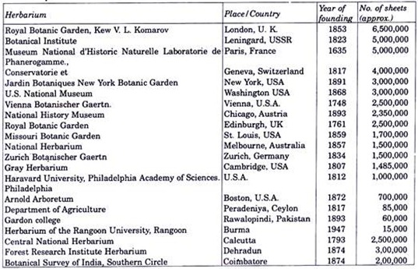
Some Important Herbarium

Slide 10
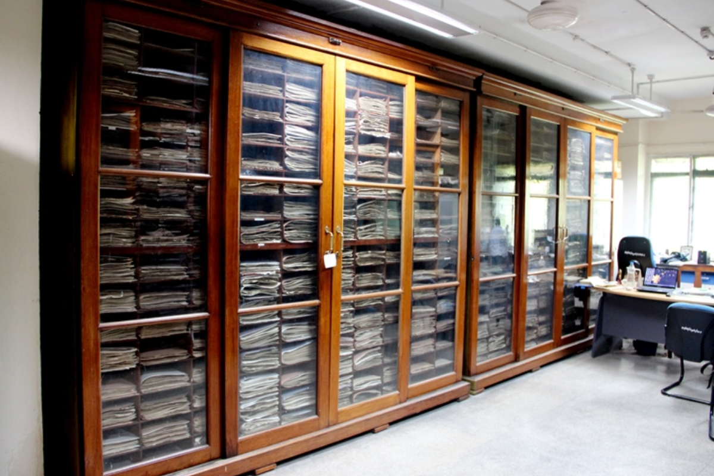
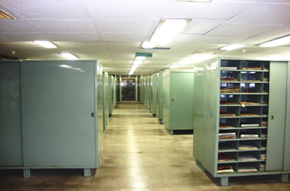
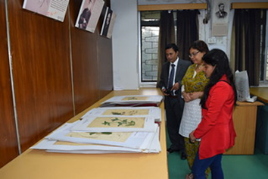
CENTRAL NATIONAL HERBARIUM

