Slide 1
DR. KANAILAL BHATTACHARYYA COLLEGE
STUDY MATERIAL FOR
ONLINE CLASS,
B.Sc. SEMESTER- I (GENERAL) STUDENTS UNDER CBCS SYSTEM
SUBJECT: BOTANY
PAPER: PLANT DIVERSITY- I
(GE-1/CC-1)
TOPIC: ANATOMY
SUBTOPIC: STOMATA
BY
DR. DIPU SAMANTA
(DEPARTMENT OF BOTANY)
FOR CORRESPONDENCE: dipusamanta2010@gmail.com

Slide 2
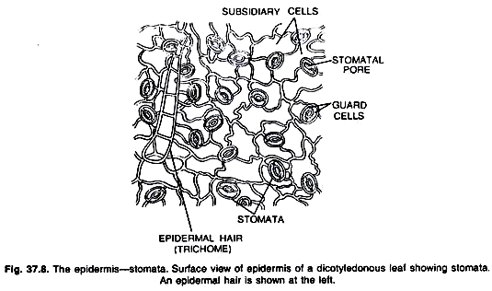
STOMATA
The stomata are minute pores which occur in the epidermis of the plants. Stoma (Stomata) remains surrounded by two kidney or bean shaped epidermal cells, the guard cells.
The stomata may occur on any part of a plant except the roots. The epidermal cells bordering the guard cells are called accessory cells or subsidiary cells.
The number of stomata may also range on the surface of a single leaf from a few thousand to hundreds of thousands per square cm.
Stomata occur on both upper and lower surfaces of leaf, but especially they are confined to the lower surface. In floating leaves Stomata are confined only on the upper surface of the leaf.
Under normal conditions the stomata remain closed in the absence of light or in night or remain open in the presence of light or in day time.
Fig. STRUCTURE OF STOMATA

Slide 3
TYPES OF STOMATA
Structurally the stomata may be of different types:
Ranunculaceous or Anomocytic:
(Anomocytic = irregular celled). In this type the stoma remains surrounded by a limited number of subsidiary cells which are quite alike the remaining epidermal cells.
Cruciferous or Anisocytic:
(Anisocytic = unequal celled) In this type stoma remains surrounded by three accessory or subsidiary cells of which one is distinctly smaller than the other two.
Rubiaceous or Paracytic:
(Paracytic = parallel celled) In this type, the stoma remains surrounded by two subsidiary or accessory cells which are parallel to the long axis of the pore and guard cells.

Slide 4
Caryophyllaceous or Diacytic:
(Diacytic = cross celled) In this type the stoma remains surrounded by a pair of subsidiary or accessory cells and whose common wall is at right angles to the guard cells.
Gramineous stomata:
The gramineous stoma possesses guard cells of which the middle portions are much narrower than the ends so that the cells appear in surface view like dumpbells. They are commonly found in Gramineae and Cyperaceae of monocotyledons.

Slide 5
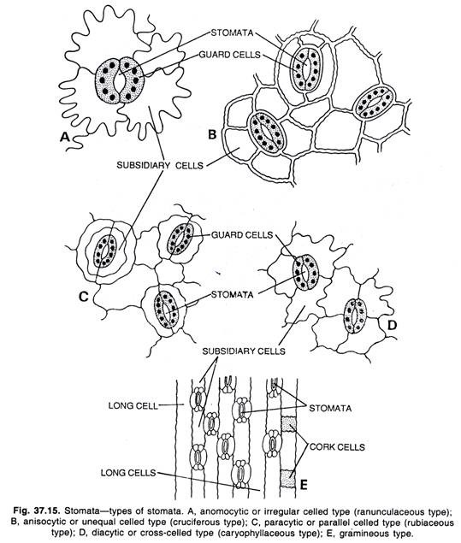
Fig. TYPES OF STOMATA
a). Anomocytic, b) Anisocytic, c) Paracytic, d) Diacytic and e) Gramineous

Slide 6
Function of Stomata:
They are used for the exchange of gases in between the plant and atmos­phere. To facilitate this function, each stoma opens in a sub-stomatal chamber or respiratory cavity.
Evaporation of water also takes place through stomata.

