Slide 1
DR. KANAILAL BHATTACHARYYA COLLEGE
STUDY MATERIAL FOR
ONLINE CLASS,
B.Sc. SEMESTER- V (HONOURS) STUDENTS UNDER CBCS SYSTEM
SUBJECT: BOTANY
PAPER: BIOCHEMISTRY
(CC-12)
TOPIC: PHOSPHORYLATION
SUBTOPIC: PHOTO-PHOSPHORYLATION AND OXIDATIVE-PHOSPHORYLATION
BY
DR. DIPU SAMANTA
(DEPARTMENT OF BOTANY)
FOR CORRESPONDENCE: dipusamanta2010@gmail.com

Slide 2
Phosphorylation
Phosphorylation is the process of production of ATP from ADP.
It is of two types: Photophosphorylation and Oxidative Phosphorylation.
Photophosphorylation is the process of utilizing light energy from photosynthesis to convert ADP to ATP.
There are two types of Photophosphorylation .
1. Cyclic Photophosphorylation and
2. Non-Cyclic Photophosphorylation.
Oxidative phosphorylation is the process by which energy from electron transport chain is used to make ATP.
Oxidative phosphorylation involves the reduction of O₂ to H₂O.

Slide 3
Photophosphorylation

Slide 4
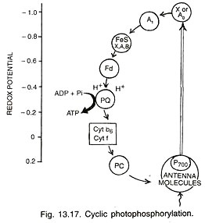
Type 1. Cyclic Photophosphorylation:
It is a process of photophosphorylation in which an electron expelled by the excited photo-centre is returned to it after passing through a series of electron carriers.
Cyclic photophosphoryla­tion is performed by photosystem I only. Its photo-centre P₇₀₀ extrudes an electron with a gain of 23 kcal/mole of energy after absorb­ing a photon of light (hv).
After losing the electron the photo-centre becomes oxidized.
The expelled electron passes through a series of carriers including X or A₀ (a special P₇₀₀ chlorophyll molecule), A, (a quinone), FeS complexes (FeS_{X}, FeS_{A}, FeS_{B}), ferredoxin, (Fd), plastoquinone (PQ), cytochrome b – f complex and plastocyanin before returning to photo centre.
While over the cytochrome com­plex, the electron energises passage of pro­tons to create a proton gradient for synthesis of ATP from ADP and inorganic phosphate.
Fig. Cyclic Photophosphorylation

Slide 5
Type 2. Non-Cyclic Photophosphorylation:
It is the process of photophosphorylation in which the electron expelled by the excited photo-centre does not return to it.
Non-cyclic photophosphorylation is carried out in collaboration of both photosystems I and II.
Electron released during photolysis of water is picked up by photo-centre of PS II called P₆₈₀. The same is extruded out when the photo Centre absorbs light energy (hv).
It passes through a series of electron carriers— phaeophytin, PQ, cytochrome b – f complex and plastocyanin.
While passing over cytochrome complex, the electron loses sufficient energy for the syn­thesis of ATP. The electron is handed over to photo Centre P₇₀₀ of PS I by plastocyanin.
P₇₀₀ extrudes the electron after absorbing light energy. The extruded electron passes through special chlorophyll X, Fe-S, ferredoxin, to finally reach NADP⁺.
The latter then combines with H⁺ (released during photolysis) with the help of NADP-reductase to form NADPH.
This is called Z scheme due to its characteristic zig-zag shape based on redox potential of different electron carriers .

Slide 6
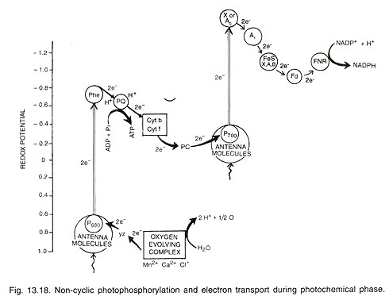
Fig. Non-Cyclic Photophosphorylation

Slide 7
Oxidative Phosphorylation

Slide 8
Oxidative Phosphorylation:
Oxidative phosphorylation is the process by which energy from electron transport chain is used to make ATP, and is the culmination of energy yielding metabolism in aerobic organisms.
Oxidative phosphorylation involves the reduction of O₂ to H₂O with electrons donated by NADH and FADH₂, and equally occurs in light or darkness.

Slide 9
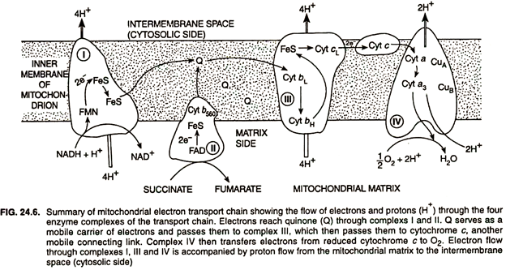
Chemiosmotic Hypothesis and Oxidative Phosphorylation:
According to chemiosmotic hypothesis the electron transport chain is organized so that protons move outward from the mitochondrial matrix to inter-membrane space.

Slide 10
Generation of Proton Motive Force (PMF):
Proton movement may result either from different complexes or from the action of special proton pumps that derive their energy from electron transport resulting in proton motive force (PMF) composed of a gradient of protons and a membrane potential due to the unequal distribution of charges.
When O₂ is reduced to H₂O after accepting electrons transferred from electron transport chain, it requires proton (H⁺) from the cytoplasm to complete the reaction.
These protons originate from the dissociation of water into H⁺ and OH–. The use of H⁺ in the reduction of O₂ to H₂O and the extrusion of H⁺ outside the membrane during electron transport chain cause a net accumulation of OH– on the inside of the membrane.
Despite their small size, because they are charged, neither H⁺ nor OH– freely passes through the membrane, and so equilibrium cannot be spontaneously restored on both sides of membrane.
This non-equilibrium state of H⁺ and OH– on opposite sides of the membrane results in the generation of a pH gradient and an electrochemical potential across the membrane, with the inside of the membrane (cytoplasm side) electrically negative and alkaline, and the outside of the membrane electrically positive and acidic.
This pH gradient and electrochemical potential cause the membrane to be energised.

Slide 11
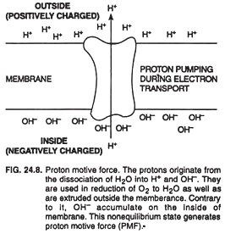
Fig. Proton Motive Force

Slide 12
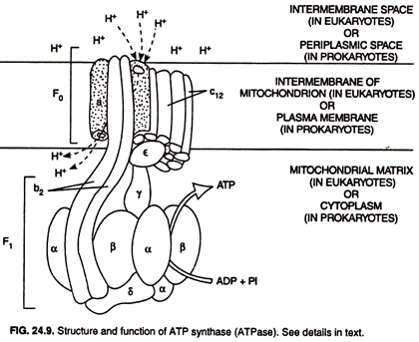
Proton Motive Force and ATP Synthesis:
Proton motive force-derived ATP synthesis involves a catalyst, which is a large membrane enzyme complex called ATP synthase or ATPase for short.
Fig. ATPase

Slide 13
The ATPase
(1) A multi-subunit head piece called F₁ located on mitochondrial matrix side (in eukaryotes) and on cytoplasmic side (in prokaryotes) and
(2) A proton conducting channel called F₀ that resides in the inner membrane of mitochondrion (in eukaryotes) and in plasma membrane (in prokaryotes) and spans the membrane.
The ATP synthesis takes place at the F₁/F₀ ATPase, which is the smallest known biological motor.
F₁, is the catalytic complex responsible for the inter conversion of ADP + Pi (inorganic phosphate) and ATP, and consists of five different polypeptides present as an α₃ β₃ ϒƐδ complex.
F₀ is integrated in the membrane and consists of three polypeptides in an ab₂ c₁₂ complex. 3, 3, 2 and 12 denote the numerical numbers of α, β, b and c, respectively.

Slide 14
Inhibition of Oxidative Phosphorylation (ATP Synthesis):
Many chemicals inhibit the synthesis of ATP and can even kill cells to sufficiently high concentrations. Inhibitors directly block electron transport chain.
The antibiotic piericidin competes with coenzyme Q; the antibiotic antimycin.
A blocks electron transport between cytochromes b, and c, and both carbon monoxide (CO) and cyanide (CN–) bind tightly to certain cytochromes and prevent their functioning.

Slide 15
Differences between oxidative phosphorylation and photophosphorylation
Points | Oxidative phosphorylation | Photophosphorylation
Site | It occurs in mitochondria | It occurs in chloroplast
Process chemistry | It involves the reduction of O₂ to H₂O with electrons donated by NADH and FADH₂.O₂ will be the final electron acceptor. | It involves the oxidation of H₂O to O₂, with NADP. NADP acts as a final electron acceptor.
Occurrence | It occurs in aerobic cells. | It occurs in photosynthetic cell
Requirement of light | It occurs well in light and dark conditions. | It occurs only in light condition
Energy | Chemical energy is converted into ATP | Light energy is converted into ATP

