Slide 1
DNA Replication
Dr. Mriganka Mandal
Dept. of Botany
Dr. Kanailal Bhattacharyya College

Slide 2
Before the nature of DNA replication was known, there were three putative hypotheses that could describe the nature of the DNA replication process. In the fist hypothesis, the daughter strand is created in a completely new manner while retaining the structure of the original parent strands. This is a conservative replication model. The second model is a semiconservative model, where the resulting products each contain one parent strand of DNA and one new strand of DNA. The third model for DNA replication is dispersive, where the parent DNA would be interspersed with newly replicated sequences of DNA.

Slide 4
The semiconservative nature of DNA was discovered through a labeling experiment using different isotopes of Nitrogen. In the first part of the experiment, the entire parental DNA is Labeled with heavy nitrogen (15N, nitrogen), the culture is then shifted and grown in 14N, nitrogen. If the DNA replication is conservative, all of the heavy nitrogen will stay together and the lighter 14N nitrogen would also stay together after one round of replication. If the DNA is replicated in a semiconservative or a dispersive model, the first round of replication would create a single band of DNA that has both the 14N and 15N mixed together within the product.

Slide 6
DNA Replication in Prokaryotes

Slide 7
One of the major features of prokaryotic DNA is the it is circular in nature, and the size of the chromosomal DNA is much smaller than eukaryotic counterparts. Thus, replication is typically characterized by having one origin of replication, called Ori, in the diagram. The ori is the site where the DNA double helix opens up and each of the strands is used as a template to synthesize the new daughter strands (shown as the dashed circles in the diagram on the right. Notice the replication is bidirectional and moves outward from the Ori in both directions.

Slide 8
Prokaryotic DNA is circular

Slide 10
This diagram gives a nice overview of the major enzymes and proteins involved with DNA replication. Once the Ori has been opened, exposing single stranded DNA a DNA replication fork can form. Leading this way is the DNA helicase enzyme that is involved in unwinding the double stranded DNA to create the single stranded bubble.

Slide 11
The Primosome
The initiation of replication at the Ori location requires the assembly of a protein complex known as the primosome.

Slide 12
DNA Polymerase Enzymes
E. coli has a total of 5 DNA Polymerase enzymes, 3 of which are involved in DNA replication (I, II, and III). DNA polymerase III is the main polymerase involved in both leading strand biosynthesis and the synthesis of the Okazaki Fragments during DNA replication. The DNA polymerase III holoenzyme is comprised of 10 different proteins organized into three functionally distinct, but physically interconnected assemblies: (1) the αεθ core, (2) the β2 sliding clamp, and (3) the δτnγ3-nδ’ΨX clamp loader complex.

Slide 13
DNA Pol III
• Polymerase
•Proofreading
DNA Pol III has both DNA Polymerase and Proofreading capabilities which give it really high fidelity. Typically it has an error rate of 1 in 1 million bases.

Slide 14
The basic idea
DNA replication is semiconservative, meaning that each strand in the DNA double helix acts as a template for the synthesis of a new, complementary strand.
This process takes us from one starting molecule to two "daughter" molecules, with each newly formed double helix containing one new and one old strand.

Slide 15
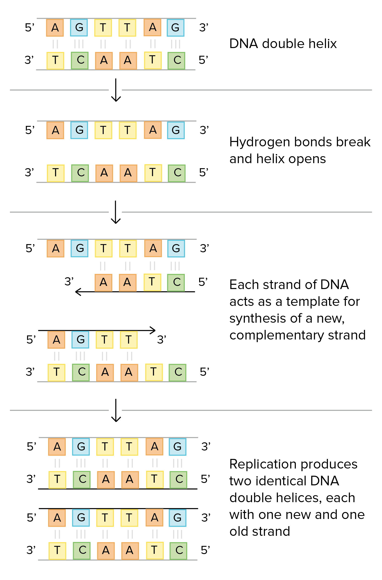

Slide 16
Starting DNA replication
How do DNA polymerases and other replication factors know where to begin? Replication always starts at specific locations on the DNA, which are called origins of replication and are recognized by their sequence.
E. coli, like most bacteria, has a single origin of replication on its chromosome. The origin is about 245245245 base pairs long and has mostly A/T base pairs (which are held together by fewer hydrogen bonds than G/C base pairs), making the DNA strands easier to separate.
Specialized proteins recognize the origin, bind to this site, and open up the DNA. As the DNA opens, two Y-shaped structures called replication forks are formed, together making up what's called a replication bubble. The replication forks will move in opposite directions as replication proceeds.

Slide 17
Primers and primase
DNA polymerases can only add nucleotides to the 3' end of an existing DNA strand. (They use the free -OH group found at the 3' end as a "hook," adding a nucleotide to this group in the polymerization reaction.)
with the help of an enzyme called primase. Primase makes an RNA primer, or short stretch of nucleic acid complementary to the template, that provides a 3' end for DNA polymerase to work on.
Once the RNA primer is in place, DNA polymerase "extends" it, adding nucleotides one by one to make a new DNA strand that's complementary to the template strand.

Slide 18
Leading and lagging strands
One new strand, which runs 5' to 3' towards the replication fork, is the easy one. This strand is made continuously, because the DNA polymerase is moving in the same direction as the replication fork. This continuously synthesized strand is called the leading strand.
The other new strand, which runs 5' to 3' away from the fork, is trickier. This strand is made in fragments is called the lagging strand.
The small fragments are called Okazaki fragments, named for the Japanese scientist who discovered them. The leading strand can be extended from one primer alone, whereas the lagging strand needs a new primer for each of the short Okazaki fragments.

Slide 19
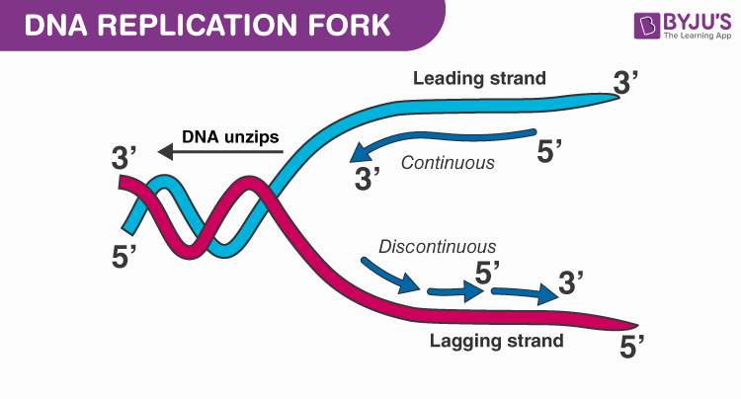

Slide 20
Termination
Termination of replication occurs in different ways in different organisms. In E.coli like organisms, chromosomes are circular. And this happens when the two replication forks between the two terminals meet each other.

